Slide 1
Objectives
Upon completion of this material, you should be able to:
Define information security
Recount the history of computer security and explain how it evolved into information security
Define key terms and critical concepts of information security
Explain the role of security in the systems development life cycle
Describe the information security roles of professionals within an organization
Notes:
Upon completion of this material, you should be able to:
Define information security
Recount the history of computer security and how it evolved into information security
Define key terms and critical concepts of information security
List the phases of the security systems development life cycle
Describe the information security roles of professionals within an organization

Slide 2
Introduction
“Enterprise information security is a critical business capability that needs to be aligned with corporate expectations and culture that provides the leadership and insight to identify risks and implement effective controls.”—Martin Fisher, IT Security Manager, North side Hospital, Atlanta, Georgia ‏
Security professionals must review the origins of this field to understand its impact on our understanding of information security today
Notes:
What Is Information Security?
Information security in today’s enterprise is a “well-informed sense of assurance that the information risks and controls are in balance.” – Jim Anderson, Inovant (2002)‏
Before we can begin analyzing the details of information security, it is necessary to review the origins of this field and its impact on our understanding of information security today.

Slide 3
The History of Information Security
Computer security began immediately after the first mainframes were developed
Groups developing code-breaking computations during World War II created the first modern computers.
Multiple levels of security were implemented.
Physical controls limiting access to sensitive military locations to authorized personnel
Rudimentary in defending against physical theft, espionage, and sabotage
Notes:
The History Of Information Security
Computer security began immediately after the first mainframes were developed
Groups developing code-breaking computations during World War II created the first modern computers
Multiple levels of security were implemented
Physical controls to limit access to sensitive military locations to authorized personnel
Rudimentary in defending against physical theft, espionage, and sabotage

Slide 4
Table 1-1 Key Dates in Information Security (1 of 2)
Date | Document
1968 | Maurice Wilkes discusses password security in Time - Sharing Computer Systems.
1970 | Willis H. Ware author the report Security Controls for Computer Systems: Report of Defense Science Board Task Force on Computer Security—RAND R.609 which was not declassified until 1979. I became known as the seminal work identifying the need for computer Security.
1973 | Schell, Downey, and Popek examine the need for additional security in military systems in Preliminary Notes on the Design of Secure Military Computer Systems.
1975 | The Federal Information Processing Standards (FIPS) examines DES (Digital Encryption Standard) In the Federal Register.
1978 | Bisbey and Hollingsworth publish their study “Protection Analysis: Final Report,” which discussed the Protection Analysis project created by ARPA to better understand the vulnerabilities of operating system security and examine the possibility of automated vulnerability detection techniques in existing system software.

Slide 5
Table 1-1 Key Dates in Information Security (2 of 2)
Date | Document
1979 | Dennis Ritchie publishes “On the Security of UNIX” and “Protection of Data File Contents,” which discussed secure user IDs, secure group IDs, and the problems inherent in the systems.
1982 | The US. Department of Defense Computer Security Evaluation Center publishes the first version of the Trusted Computer Security (TCSEC) documents, which came to be known as the Rainbow Series.
1982 | Grampp and Morris write “The UNIX System: UNIX Operating System Security.” In this report the authors examined four “important handles to computer security”: physical control of primes and computer facilities, management commitment to security objectives, education of employees, and administrative procedures aimed at increased security.
1984 | Reeds and Weinberger publish “File Security and the UNIX System Crypt Command.” Their premise was: “No technique can be secure against wiretapping or is equivalent on the computer. Therefore no technique can be secure against the system administrator or other privileged users... the naive user have no chance.”
1992 | Researchers for the Internet Engineering Task force, working at the Naval Research Laboratory, develop the Simple Internet Protocol Plus (SIPP) Security protocols, creating what is now known as IPSEC security.

Slide 6
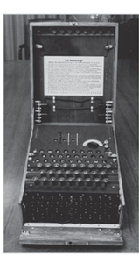
Figure 1-1 The Enigma (1 of 2)
Source. Bletchley Park Trust. Used with permission.
Notes:
This picture shows a high-visibility artifact associated with the early days of information security – focusing on the confidentiality of information. This artifact is also part of the study of cryptography from Chapter 8.

Slide 7
Figure 1-1 The Enigma (2 of 2)
Earlier versions of the German code machine Enigma were first broken by the Poles in the 1930s. The British and Americans managed to break later, more complex versions during World War II. The increasingly complex versions of the Enigma, especially the submarine or Unterseeboot version of the Enigma, caused considerable anguish to Allied forces before finally being cracked. The information gained from decrypted transmissions was used to anticipate the actions of German armed forces. 'Some ask why, if we were reading the Enigma, we did not win the war earlier. One might ask, instead, when, if ever, we would have won the war if we hadn't read it'

Slide 8
The 1960s
Advanced Research Projects Agency (ARPA) began to examine the feasibility of redundant networked communications.
Larry Roberts developed the ARPANET from its inception.
Notes:
The 1960s
During the 1960s, the Department of Defense’s Advanced Research Procurement Agency (ARPA) began examining the feasibility of a redundant networked communications system designed to support the military’s need to exchange information.
Larry Roberts, known as the founder of the Internet, developed the project from its inception.

Slide 9
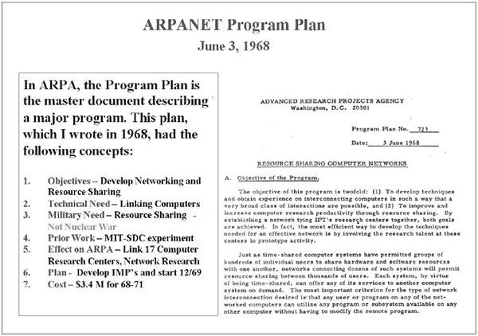
Figure 1-2 Development of the ARPANET
Source. Courtesy of Dr. Lawrence Roberts. Used with permission.
Notes:
This picture shows a high-visibility artifact associated with the early days of information security – focusing on the confidentiality of information. This artifact is also part of the study of cryptography from Chapter 8.

Slide 10
The 1970s and 80s (1 of 2)
ARPANET grew in popularity, as did its potential for misuse.
Fundamental problems with ARPANET security were identified.
No safety procedures for dial-up connections to ARPANET
Nonexistent user identification and authorization to system
Notes:
The 1970s and 80s
ARPANET grew in popularity as did its potential for misuse
Fundamental problems with ARPANET security were identified
No safety procedures for dial-up connections to ARPANET
Nonexistent user identification and authorization to system
Late 1970s: microprocessor expanded computing capabilities and security threats

Slide 11
The 1970s and 80s (2 of 2)
Information security began with RAND Report R-609 (paper that started the study of computer security and identified the role of management and policy issues in it)‏.
The scope of computer security grew from physical security to include:
Securing the data
Limiting random and unauthorized access to data
Involving personnel from multiple levels of the organization in information security
Notes:
The 1970s and 80s (cont’d.)
Information security began with Rand Report R-609 (paper that started the study of computer security and identified role of management and policy issues in it)‏
Scope of computer security grew from physical security to include:
Securing the data
Limiting random and unauthorized access to data
Involving personnel from multiple levels of the organization in information security

Slide 12
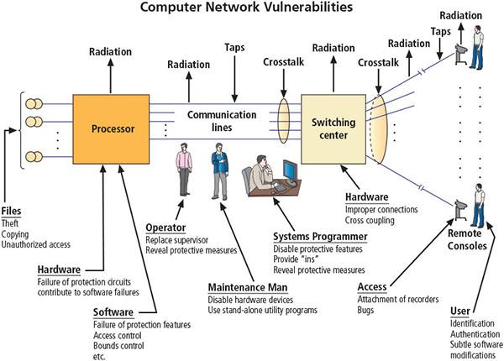
Figure 1-4 Illustration of computer network vulnerabilities from RAND Report R-609
Source. RAND Report R-609-1. Used with permission.

Slide 13
MULTICS (1 of 2)
Early focus of computer security research centered on a system called Multiplexed Information and Computing Service (MULTICS)‏.
First operating system was created with security integrated into core functions.
Mainframe, time-sharing operating system was developed in the mid-1960s by General Electric (GE), Bell Labs, and Massachusetts Institute of Technology (MIT)‏.
Notes:
MULTICS
Early focus of computer security research centered on a system called Multiplexed Information and Computing Service (MULTICS)‏
First operating system created with security integrated into core functions
Mainframe, time-sharing OS developed in mid-1960s by General Electric (GE), Bell Labs, and Massachusetts Institute of Technology (MIT)‏
Several MULTICS key players created UNIX
Primary purpose of UNIX was text processing
Late 1970s: microprocessor expanded computing capabilities and security threats

Slide 14
MULTICS (2 of 2)
Several MULTICS key players created UNIX.
Primary purpose of UNIX was text processing.
Late 1970s: The microprocessor expanded computing capabilities and security threats.

Slide 15
The 1990s
Networks of computers became more common, as did the need to connect them to each other.
Internet became the first global network of networks.
Initially, network connections were based on de facto standards.
In early Internet deployments, security was treated as a low priority.
In 1993, DEFCON conference was established for those interested in information security.
Notes:
The 1990s
Networks of computers became more common; so did the need to connect them to each other
Internet became first global network of networks
Initially based on de facto standards
In early Internet deployments, security was treated as a low priority
In 1993, DEFCON conference established for those interested in information security

Slide 16
2000 to Present
The Internet brings millions of unsecured computer networks into continuous communication with each other.
The ability to secure a computer’s data was influenced by the security of every computer to which it is connected.
Growing threat of cyber attacks has increased the awareness of need for improved security.
Nation-states engaging in information warfare
Notes:
2000 to Present
The Internet brings millions of unsecured computer networks into continuous communication with each other
Ability to secure a computer’s data influenced by the security of every computer to which it is connected
Growing threat of cyber attacks has increased the awareness of need for improved security
Nation-states engaging in information warfare

Slide 17
What Is Security? (1 of 2)
“A state of being secure and free from danger or harm; the actions taken to make someone or something secure.”
A successful organization should have multiple layers of security in place to protect:
Operations
Physical infrastructure
People
Functions
Communications
Information
Notes:
What Is Security?
“A state of being secure and free from danger or harm; the actions taken to make someone or something secure”
A successful organization should have multiple layers of security in place to protect:
Operations
Physical Infrastructure
People
Functions
Communications
Information

Slide 18
What Is Security? (2 of 2)
The protection of information and its critical elements, including systems and hardware that use, store, and transmit that information
Includes information security management, data security, and network security
C.I.A. triad
Is a standard based on confidentiality, integrity, and availability, now viewed as inadequate.
Expanded model consists of a list of critical characteristics of information.
Notes:
What Is Security? (cont’d.)
The protection of information and its critical elements, including systems and hardware that use, store, and transmit that information
Includes information security management, data security, and network security
C.I.A. triangle
Is standard based on confidentiality, integrity, and availability, now viewed as inadequate
Expanded model consists of a list of critical characteristics of information

Slide 19
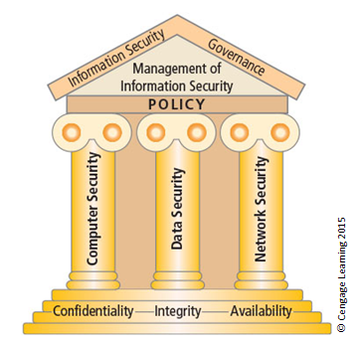
Figure 1-5 Components of information security (1 of 2)

Slide 20
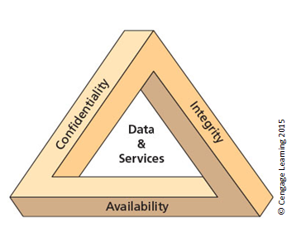
Figure 1-5 The C.I.A. triad (2 of 2)

Slide 21
Key Information Security Concepts (1 of 3)
Access
Asset
Attack
Control, safeguard, or countermeasure
Exploit
Exposure
Loss
Protection profile or security posture
Notes:
Key Terms
Access - a subject or object’s ability to use, manipulate, modify, or affect another subject or object.
Asset - the organizational resource that is being protected.
Attack - an intentional or unintentional act that can damage or otherwise compromise information and the systems that support it.
Control, Safeguard, or Countermeasure - Security mechanisms, policies, or procedures that can successfully counter attacks, reduce risk, resolve vulnerabilities, and otherwise improve security within an organization.
Exploit – a technique used to compromise a system.
Exposure - a condition or state of being exposed.
Loss: A single instance of an information asset suffering damage or destruction, unintended or unauthorized modification or disclosure, or denial of use.
Protection Profile or Security Posture-entire set of controls and safeguards that the organization implements to protect the asset.
Risk - the probability of an unwanted occurrence.
Subjects and Objects – a computer can be either an agent entity used to conduct an attack, or the target entity.
Threat - a category of objects, people, or other entities that represents a danger to an asset.
Threat Agent – the specific instance or a component of a threat.
Vulnerability - weaknesses or faults in a system or protection mechanism that expose information to attack or damage.

Slide 22
Key Information Security Concepts (2 of 3)
Risk
Subjects and objects of attack
Threat
Threat agent
Threat event
Threat source
Vulnerability

Slide 23
Key Information Security Concepts (3 of 3)
A computer can be the subject of an attack and/or the object of an attack.
When it is the subject of an attack, the computer is used as an active tool to conduct attack.
When it is the object of an attack, the computer is the entity being attacked.
Notes:
Key Information Security Concepts
When considering the security of information systems components, it is important to understand the concept of the computer as the subject of an attack as opposed to the computer as the object of an attack.
When a computer is the subject of an attack, it is used as an active tool to conduct the attack. When a computer is the object of an attack, it is the entity being attacked.

Slide 24
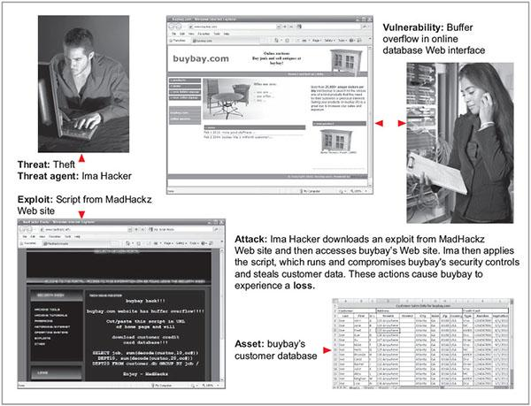
Figure 1-7 Key concepts in information security
Source. (top left to bottom right): © iStockphoto/tadija, Internet Explorer, © iStockphoto/darrenwise , Internet Explorer, Microsoft Excel.

Slide 25
Critical Characteristics of Information
The value of information comes from the characteristics it possesses:
Availability
Accuracy
Authenticity
Confidentiality
Integrity
Utility
Possession
Notes:
Critical Characteristics of Information
The value of information comes from the characteristics it possesses.
Availability – Enables users who need to access information to do so without interference or obstruction and in the required format. The information is said to be available to an authorized user when and where needed and in the correct format.
Accuracy – Free from mistake or error and having the value that the end user expects. If information contains a value different from the user’s expectations due to the intentional or unintentional modification of its content, it is no longer accurate.
Authenticity –The quality or state of being genuine or original, rather than a reproduction or fabrication. Information is authentic when it is the information that was originally created, placed, stored, or transferred.
Confidentiality – The quality or state of preventing disclosure or exposure to unauthorized individuals or systems.
Integrity – The quality or state of being whole, complete, and uncorrupted. The integrity of information is threatened when the information is exposed to corruption, damage, destruction, or other disruption of its authentic state.
Utility – The quality or state of having value for some purpose or end. Information has value when it serves a particular purpose. This means that if information is available, but not in a format meaningful to the end user, it is not useful.
Possession – The quality or state of having ownership or control of some object or item. Information is said to be in possession if one obtains it, independent of format or other characteristic. While a breach of confidentiality always results in a breach of possession, a breach of possession does not always result in a breach of confidentiality.

Slide 26
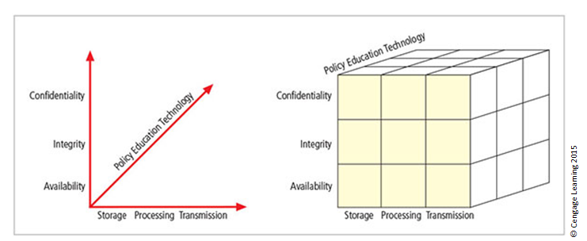
Figure 1-9 The McCumber Cube
Notes:
This graphic informs the fundamental approach of the chapter and can be used to illustrate the intersection of information states (x-axis), key objectives of C.I.A. (y-axis), and the three primary means to implement (policy, education, and technology).

Slide 27
Components of an Information System
Information system (IS) is the entire set of people, procedures, and technology that enable business to use information.
Software
Hardware
Data
People
Procedures
Networks
Notes:
Components of an Information System
Information system (IS) is entire set of people, procedures, and technology that enable business to use information.
Software
Hardware
Data
People
Procedures
Networks

Slide 28
Balancing Information Security and Access
Impossible to obtain perfect information security—it is a process, not a goal.
Security should be considered a balance between protection and availability.
To achieve balance, the level of security must allow reasonable access, yet protect against threats.
Notes:
Security and Access Balancing
When considering information security, it is important to realize that it is impossible to obtain perfect security. Security is not an absolute; it is a process not a goal.
Security should be considered a balance between protection and availability.
To achieve balance, the level of security must allow reasonable access yet protect against threats.

Slide 29
Approaches to Information Security Implementation: Bottom-Up Approach
Grassroots effort: Systems administrators attempt to improve security of their systems.
Key advantage: technical expertise of individual administrators
Seldom works, as it lacks a number of critical features:
Participant support
Organizational staying power
Notes:
Bottom-up Approach to Security Implementation
Security can begin as a grass-roots effort when systems administrators attempt to improve the security of their systems. This is referred to as the bottom-up approach.
The key advantage of the bottom-up approach is the technical expertise of the individual administrators.
Unfortunately, this approach seldom works, as it lacks a number of critical features, such as participant support and organizational staying power.

Slide 30
Approaches to Information Security Implementation: Top-Down Approach
Initiated by upper management
Issue policy, procedures, and processes
Dictate goals and expected outcomes of project
Determine accountability for each required action
The most successful type of top-down approach also involves a formal development strategy referred to as systems development life cycle.
Notes:
Top-down Approach to Security Implementation
An alternative approach, which has a higher probability of success, is called the top-down approach. The project is initiated by upper management who issue policy, procedures, and processes; dictate the goals and expected outcomes of the project; and determine who is accountable for each of the required actions.
The top-down approach has strong upper-management support, a dedicated champion, dedicated funding, clear planning, and the opportunity to influence organizational culture.
The most successful top-down approach also involves a formal development strategy referred to as a systems development life cycle.

Slide 31
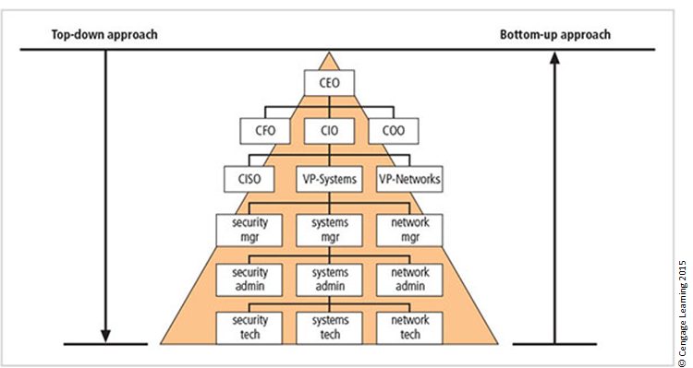
Figure 1-12 Approaches to information security implementation
Notes:
The key concept here is the direction of the left and right side arrows to show where planning is sourced and from which direction the pressure for success is driven.

Slide 32
Security in the Systems Development Life Cycle
Systems development life cycle (SDLC): a methodology for the design and implementation of an information system
Methodology: a formal approach to solving a problem based on a structured sequence of procedures
Using a methodology:
Ensures a rigorous process with a clearly defined goal
Increases probability of success
Notes:
The Systems Development Life Cycle
Systems Development Life Cycle (SDLC): methodology for design and implementation of an information system
Methodology: formal approach to solving a problem based on a structured sequence of procedures
Using a methodology:
Ensures a rigorous process with a clearly defined goal
Increases probability of success
Traditional SDLC consists of six general phases

Slide 33
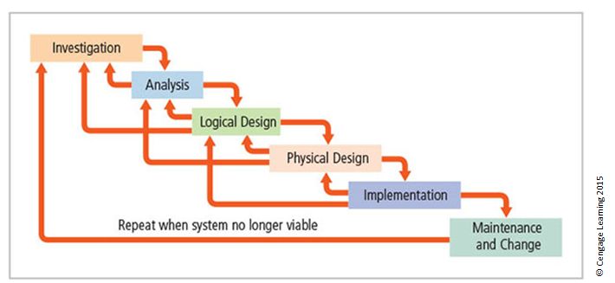
Figure 1-13 SDLC waterfall methodology
Notes:
Very much a traditional SDLC diagram.

Slide 34
Investigation
What problem is the system being developed to solve?
Objectives, constraints, and scope of project are specified.
Preliminary cost-benefit analysis is developed.
At the end of all phases, a process is undertaken to assess economic, technical, and behavioral feasibilities and ensure implementation is worth the time and effort.
Notes:
Investigation
What problem is the system being developed to solve?
Objectives, constraints, and scope of project are specified
Preliminary cost-benefit analysis is developed
At the end of all phases, a process is undertaken to assess economic, technical, and behavioral feasibilities and ensure implementation is worth time and effort

Slide 35
Analysis
Consists of assessments of:
The organization
Current systems
Capability to support proposed systems
Analysts determine what the new system is expected to do and how it will interact with existing systems.
Analysis ends with documentation of findings and an update of feasibility.
Notes:
Analysis
The analysis phase begins with the information learned during the investigation phase.
This phase consists primarily of assessments of the organization, the status of current systems, and the capability to support the proposed systems.
Analysts begin to determine what the new system is expected to do and how it will interact with existing systems.
This phase ends with the documentation of the findings and a feasibility analysis update.

Slide 36
Logical Design
The first and driving factor is the business need.
Applications are selected to provide needed services.
Data support and structures capable of providing the needed inputs are identified.
Specific technologies are delineated to implement the physical solution.
Analysts generate estimates of costs and benefits to allow comparison of available options.
Feasibility analysis is performed at the end.
Notes:
Logical Design
First and driving factor is business need
Applications are selected to provide needed services
Data support and structures capable of providing the needed inputs are identified
Specific technologies are delineated to implement the physical solution
Analysts generate estimates of costs and benefits to allow comparison of available options
Feasibility analysis performed at the end

Slide 37
Physical Design
Specific technologies are selected to support the alternatives identified and evaluated in the logical design.
Selected components are evaluated on make-or-buy decision.
Feasibility analysis is performed.
Entire solution is presented to organization’s management for approval.
Notes:
Physical Design
Specific technologies selected to support the alternatives identified and evaluated in the logical design
Selected components evaluated on make-or-buy decision
Feasibility analysis performed
Entire solution presented to organization’s management for approval

Slide 38
Implementation
Needed software is created.
Components are ordered, received, and tested.
Users are trained and supporting documentation created.
Feasibility analysis is prepared.
Sponsors are presented with the system for a performance review and acceptance test.
Notes:
Implementation
Needed software created
Components ordered, received, and tested
Users trained and supporting documentation created
Feasibility analysis prepared
Sponsors presented with system for performance review and acceptance test

Slide 39
Maintenance and Change
Longest and most expensive phase
Consists of the tasks necessary to support and modify the system for the remainder of its useful life
Life cycle continues until the team determines the process should begin again from the investigation phase
When current system can no longer support the organization’s mission, a new project is implemented
Notes:
Maintenance and Change
The maintenance and change phase is the longest and most expensive phase of the process.
This phase consists of the tasks necessary to support and modify the system for the remainder of its useful life cycle.
Even though formal development may conclude during this phase, the life cycle of the project continues until it is determined that the process should begin again from the investigation phase. When the current system can no longer support the changed mission of the organization, the project is terminated and a new project is implemented.

Slide 40
Software Assurance
Many organizations recognize the need to include planning for security objectives in the SDLC used to create systems.
Established procedures to create software that is more capable of being deployed in a secure fashion
This approach is known as software assurance (SA).
A national effort is under way to create a common body of knowledge focused on secure software development.
Notes:
Many organizations recognize need to include planning for security objectives in the SDLC used to create systems
Established procedures to create software more capable of being deployed in a secure fashion
This approach known as software assurance (SA)
Software Assurance Initiative resulted in publication of Secure Software Assurance (SwA) Common Body of Knowledge (CBK)

Slide 41
Software Assurance
Secure Software Requirements
Secure Software Design
Secure Software Construction
Secure Software Verification, Validation, and Evaluation
Secure Software Tools and Methods
Secure Software Processes
Secure Software Project Management
Acquisition of Secure Software
Secure Software Sustainment

Slide 42
Software Design Principles (1 of 2)
Good software development results in secure products that meet all design specifications.
Some commonplace security principles
Keep design simple and small
Access decisions by permission not exclusion
Every access to every object checked for authority
Design depends on possession of keys/passwords
Protection mechanisms require two keys to unlock
Programs/users utilize only necessary privileges

Slide 43
Software Design Principles (2 of 2)
Some commonplace security principles
Minimize mechanisms common to multiple users
Human interface must be easy to use so users routinely/automatically use protection mechanisms.

Slide 44
Summary (1 of 2)
Computer security began immediately after the first mainframes were developed.
Successful organizations have multiple layers of security in place: physical, personal, operations, communications, network, and information.
Security should be considered a balance between protection and availability.

Slide 45
Summary (2 of 2)
Information security must be managed similar to any major system implemented in an organization using a methodology like the SDLC.

